Slide 1
Team Member(s): Olena Tkachenko, Renan Santana Product Owner(s): Ali Mostafavi, Leo Bobadilla Instructor: Masoud Sadjadi School of Computing and Information Sciences Florida International University
Senior Project Final Presentation Spring 2016
Urban Decision Theatre 1.0
<5/6/2016>
Notes:
Greet your audience, thank them for attending your presentation, introduce yourself, introduce your project, introduce your team members, and quickly indicate what each of you did in a high-level manner, and put more emphasis on your part/contribution.

Slide 2
Problem definition
Extreme events such as flooding and storm surges due to sea-level rise are significant threats to urban areas and Urban City Planners do not have robust tools to assist them in decision-making
Risky trial & error learning process.
UDT 1.0 will simulate these flooding scenarios to allow Urban City Planners to practice and model their decisions with limited time and budget to find the best available outcome.
It will model: traffic, city flood pumps, time, budget, sea-level and tide
Notes:
Introduce the problem that the whole project tackles and stay focused on the parts that you have been working. Indicate if there is an existing previous system, enumerate its problems/limitations, etc.
Extreme events such as flooding and storm surges due to sea-level rise are significant threats to urban areas and decision-makers do not have robust tools to assist them in decision-making.

Slide 3
User Stories/features Implemented
Starting Budget Selection
Navigation & Enable Oculus
Pump w/Pump Costs
View Perspectives: FPV & bird’s eye
Store Decisions
Notes:
4. Requirements:
4.1. User stories implemented (one or more slides).
4.2. UML use cases and the use case diagram for the implemented use cases (one or more slides).
4.3. UML sequence diagrams for the implemented use cases.

Slide 4
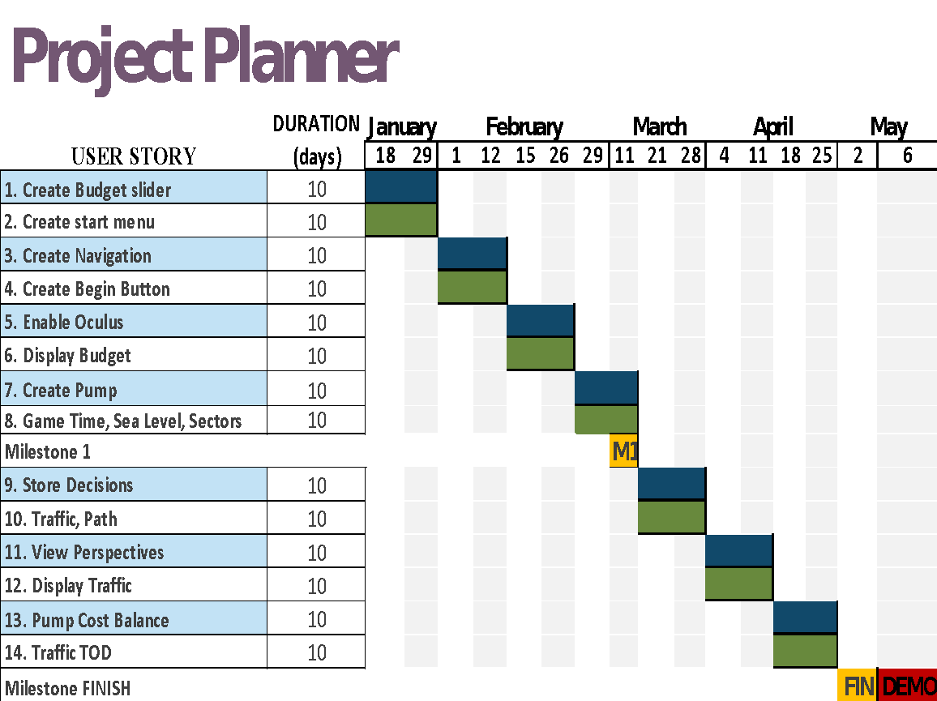
Notes:
Project Management (schedule for entire semester) (one slide; Gantt Chart).

Slide 5
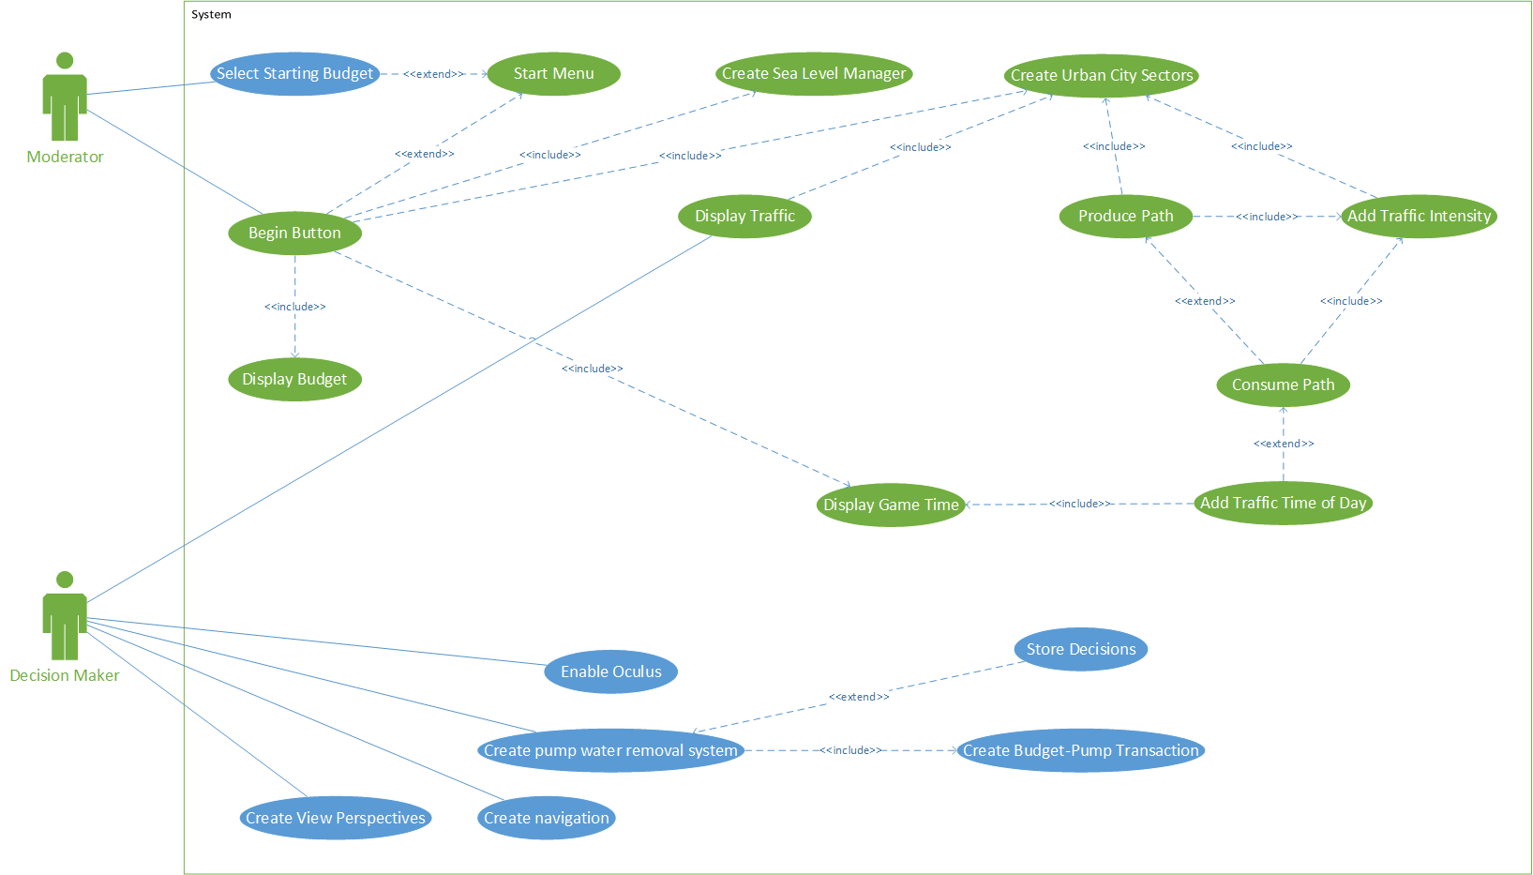
Use Case Diagram
Notes:
4. Requirements:
4.1. User stories implemented (one or more slides).
4.2. UML use cases and the use case diagram for the implemented use cases (one or more slides).
4.3. UML sequence diagrams for the implemented use cases.

Slide 6
Create View Perspectives Use Case
ACTORS: Decision Maker
DESCRIPTION:
Use case begins when the Decision Maker scrolls via the Mouse Scroll wheel in any direction.
The system lifts the first person view about 40 feet off the city ground.
The Decision Maker presses “Shift+B”.
The system switches the Decision Maker to far away Bird’s View(above) of the City.
Use case ends when Decision Maker exits the game.
Notes:
4. Requirements:
4.1. User stories implemented (one or more slides).
4.2. UML use cases and the use case diagram for the implemented use cases (one or more slides).
4.3. UML sequence diagrams for the implemented use cases.

Slide 7
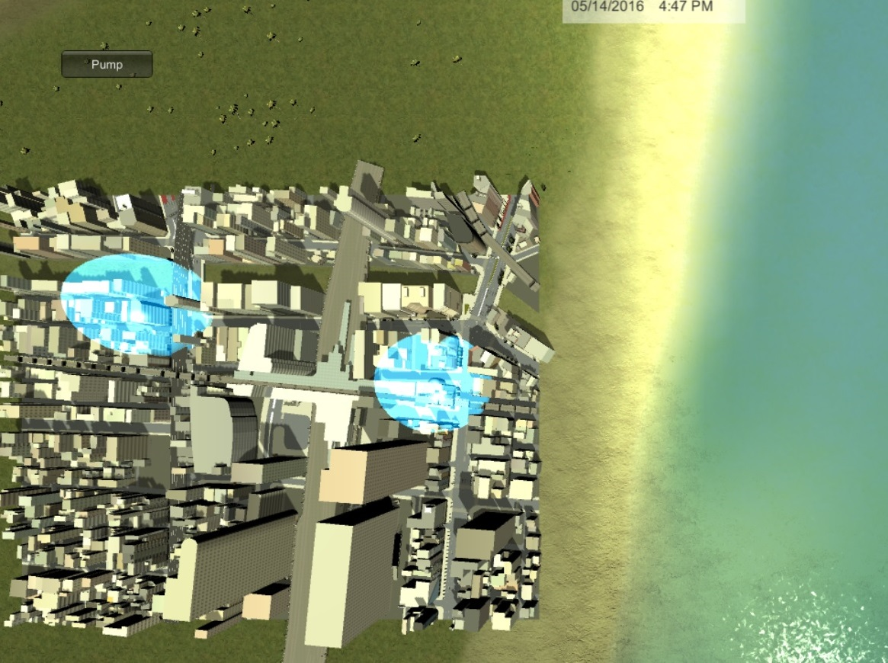
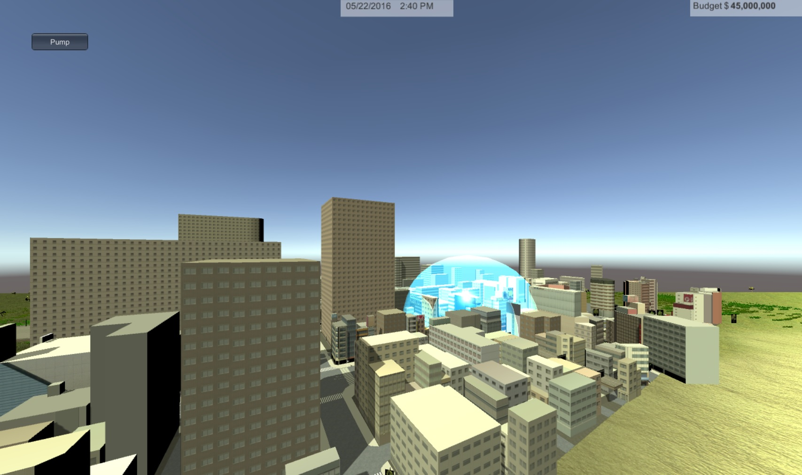
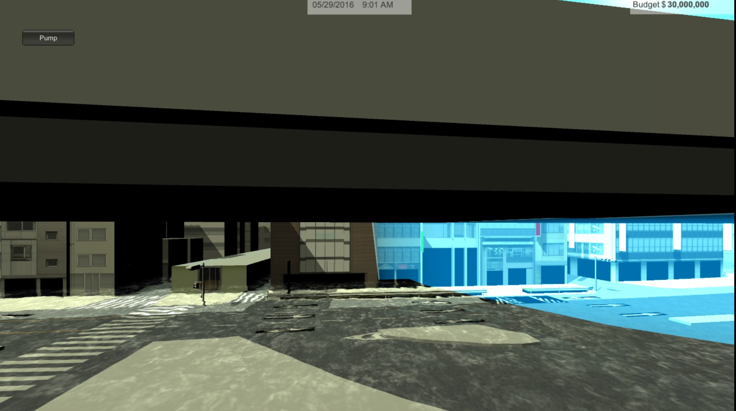
Notes:
4. Requirements:
4.1. User stories implemented (one or more slides).
4.2. UML use cases and the use case diagram for the implemented use cases (one or more slides).
4.3. UML sequence diagrams for the implemented use cases.

Slide 8
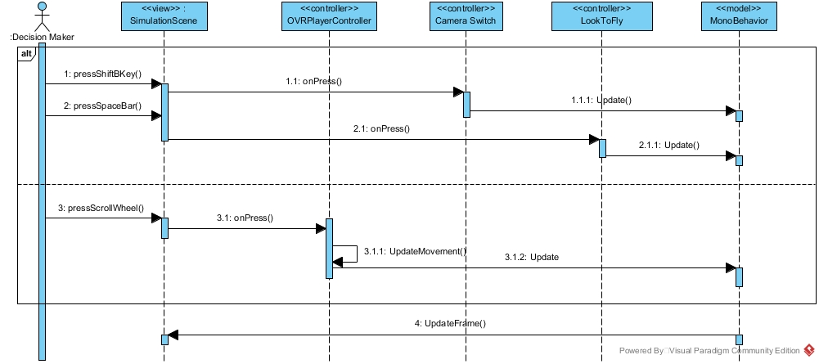
Sequence Diagram
Notes:
4. Requirements:
4.1. User stories implemented (one or more slides).
4.2. UML use cases and the use case diagram for the implemented use cases (one or more slides).
4.3. UML sequence diagrams for the implemented use cases.

Slide 9
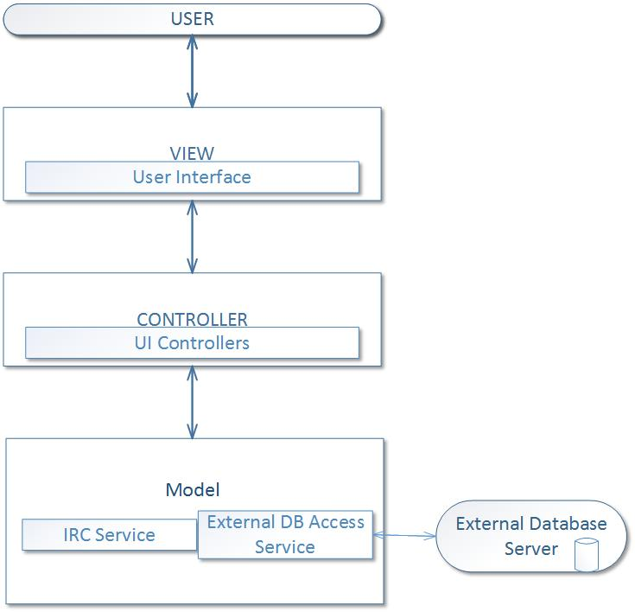
Architecture
Notes:
5. System design:
5.1. System decomposition; identify the architecture patterns used (one slide).
5.2. System deployment – h/w and s/w requirements (one slide).
5.3. Persistent data design (one slide).
5.4. Security/Privacy (one slide).

Slide 10
Deployment
Notes:
5. System design:
5.1. System decomposition; identify the architecture patterns used (one slide).
5.2. System deployment – h/w and s/w requirements (one slide).
5.3. Persistent data design (one slide).
5.4. Security/Privacy (one slide).

Slide 11
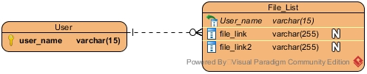
Data & Security
Persistent data design:
Table of user_name’s each user having a list of files with their decision making information
Security/Privacy
IRC and Mongo encryption service (AES256-CBC)
Notes:
5. System design:
5.1. System decomposition; identify the architecture patterns used (one slide).
5.2. System deployment – h/w and s/w requirements (one slide).
5.3. Persistent data design (one slide).
5.4. Security/Privacy (one slide).

Slide 12
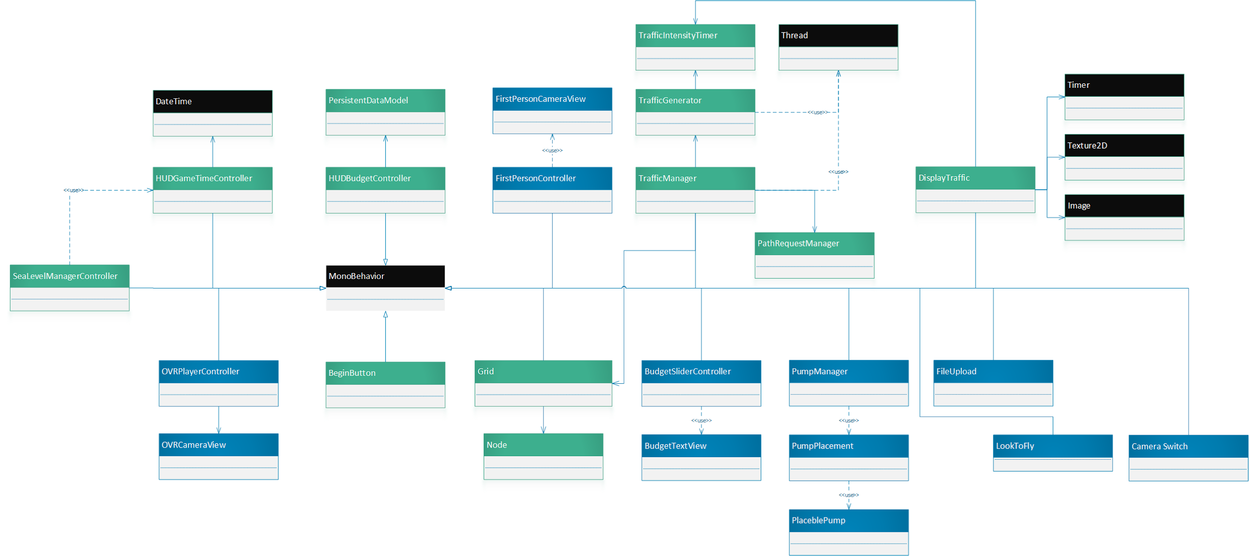
Minimal Class Diagram
Notes:
6. Detailed design:
6.1. Minimal class diagram. Identify the design patterns used (one or more slides).
6.2. State machine for the main control object or the most important object of the implemented uses cases (one or more slides).
6.3. Main algorithm used related to an implemented use case described above (one or more slides).

Slide 13
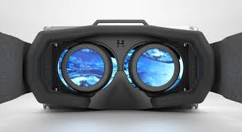
Algorithm for Oculus OVR player movement
Get input from oculus, mouse, keyboard…
i.e Primary Shoulder, Secondary Shoulder
Apply the movement scale if a combination of keys is pressed at the same time
-Combination of keys=> reduced vector distance rather than straight path
Apply Gravity if not Flying/Floating.
Move player in any of the 6DoF (movement of a body in 3-D space)
Notes:
6. Detailed design:
6.1. Minimal class diagram. Identify the design patterns used (one or more slides).
6.2. State machine for the main control object or the most important object of the implemented uses cases (one or more slides).
6.3. Main algorithm used related to an implemented use case described above (one or more slides).
6 degrees of freedom- freedom of movement of a rigid body in 3 dimensional space.
Change position in any direction of x,y,x axis’

Slide 14
Sunny Test case: validate head movement
Identifier | UDT717-Navigation
Purpose | To ensure that head movement works as expected.
Pre-conditions | The Decision Maker is in the city scene.
Input | Head movement to the right.
Expected Output | The Decision Maker is viewing the scene to his right.
Notes:
7. Test Suites and Test Cases (one sunny day and one rainy day) for the use case represented in part (5) above (2 slides).
7.1 One sunny day and one rainy day for the implemented use cases (one or more slides).
7.2 Automated test scripts for the implemented use cases (one or more slides).

Slide 15
Rainy Test case: register Oculus
Identifier | UDT717-register Oculus
Purpose | Display error message when Oculus is not registered by the game.
Pre-conditions | The Decision Maker is in the city scene and Oculus device is not hooked up.
Input | None
Expected Output | [VRDevice] Initialization of device oculus failed.
Notes:
7. Test Suites and Test Cases (one sunny day and one rainy day) for the use case represented in part (5) above (2 slides).
7.1 One sunny day and one rainy day for the implemented use cases (one or more slides).
7.2 Automated test scripts for the implemented use cases (one or more slides).

Slide 16
Summary of user stories implemented:
Oculus component & navigation
Starting budget selection and flood pump system w/real world Costs
diff View Perspectives –birds eye, gravity, FPV
Storage of Decisions in Mongo Database
To provide VR supported experience to Urban City Planners, to help them in evaluating various flooding and sea level rise scenarios and make robust decisions
contact information:
-Olena Tkachenko: otkac001@fiu.edu
Questions?
Thank You!
Notes:
Summarize your contribution
Include your contact information
Ask if anyone has any questions for you.
Thank your audience

